Slide 1
Numbers and Error Analysis

Slide 2
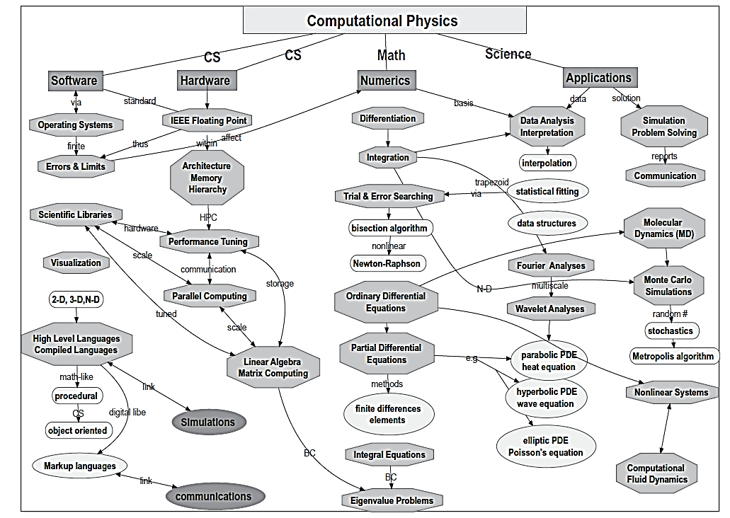
c
c
c
c
c
c
c
c
c
c
c
c
c
c
c
c
c
c
c
c
c
c

Slide 3
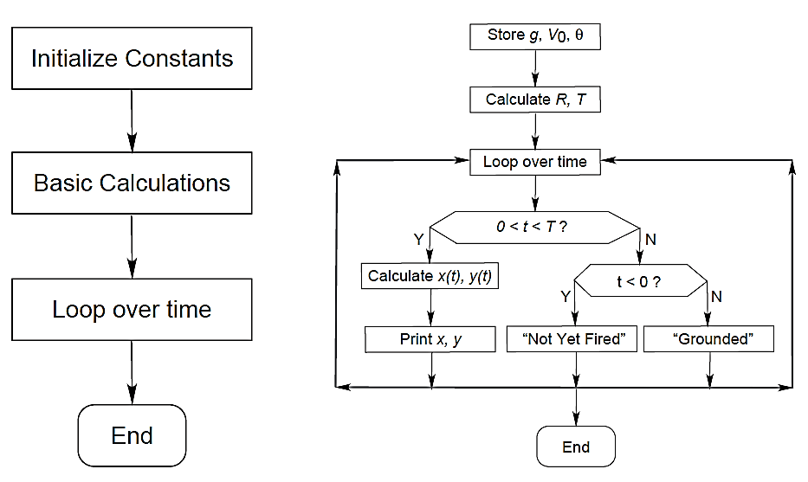
Basic FlowCharts…
c
c
c
c
c

Slide 4
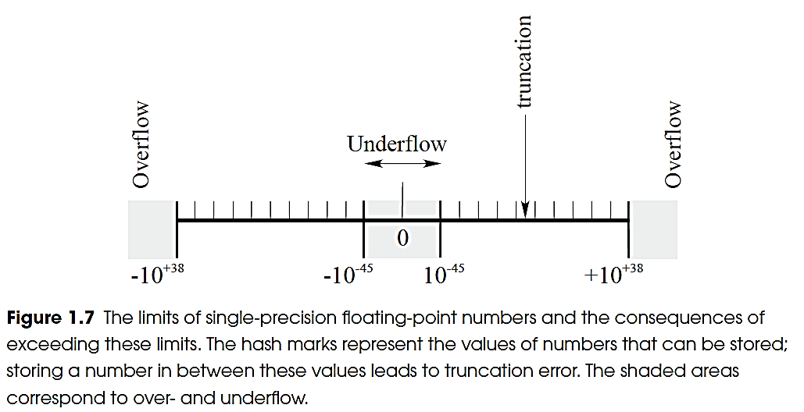
Storing numbers (x86 or 32bits)
c
c

Slide 5
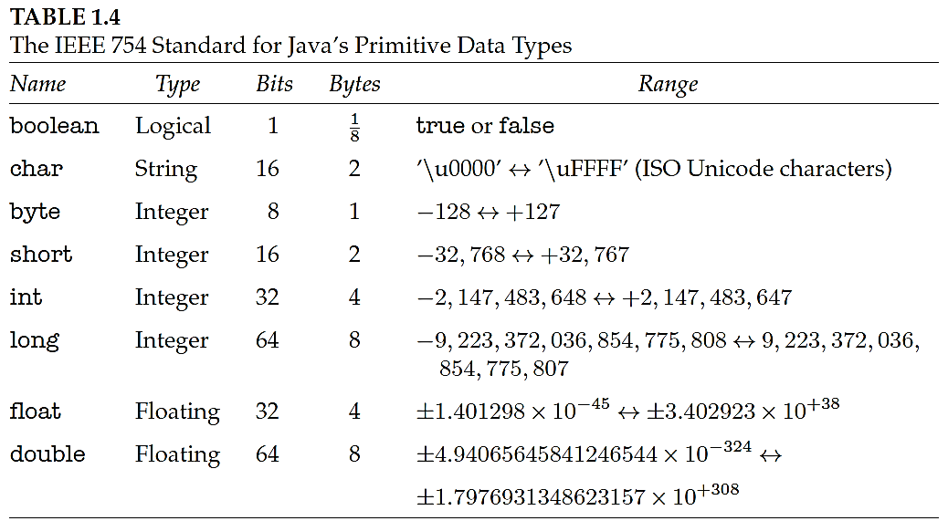
c
c

Slide 6
Errors → Types/Classes
Errors arise in computations due to a variety of reasons…
Theory Errors
The underlying theoretical framework may contain errors.
Theory may have inherent divergent behavior which may result in “data out-of-bounds” situations. For example, we need to perform “Renormalization” in Quantum Electrodynamics to tackle the infinite-sum problem.
Random Errors
Data storage in computers is subject to random fluctuations in voltages/currents.
The computer circuit boards may pick random noise signals from nearby devices.
While algorithms are in place for self-correction for transmission and storage of data, they do have limits.

Slide 7
Continued…
Modelling Errors
A mathematical model is built to represent a physical process or a phenomenon. When a mathematical model being formulated is not exact/accurate when compared to the underlying physical process, errors can occur in the resulting solution.
Models often require many simplifying assumptions. The physical process being modelled may be overly complex in some cases. In such situations, it will be impossible/impractical to create an exact mathematical model. Hence, the resultant model may be a simplified version of the underlying physical process.

Slide 8
Modeling Errors (continued…)
Some examples of model simplification, resulting in errors:
While calculating the force acting on a freely falling body, we may assume that the drag coefficient (air resistance) is linearly proportional to velocity of the falling body. This simplification will have its impact on the accuracy of the result.
While evaluating disease control programs, mainly epidemiological factors are included in the model, while others like social factors may be left out to make the model less complex.

Slide 9
Inherent Errors / Input Errors
Errors that are present in the data that are input to the model are inherent errors. They are also called input errors. They are classified into two – Data Errors and Conversion Errors.
Data Errors
Data errors arise when data to be input into a model are acquired using experimental methods.
These are also called empirical errors. Such errors occur mostly due to the limitations or errors in the instrumentation.
A voltage reading can be accurate only upto the accuracy of the voltmeter. Similarly, the accuracy of distance measurement is limited by the accuracy of the instrument used to measure distance.

Slide 10
Conversion Errors
Conversion errors arise due to the limitation of computers to store exact decimal data.
Hence, these are called representational errors. In a floating point representation, a computer can only retain a limited number of digits.
Digits that are not retained causes a round-off error.
When a floating point number is converted into its binary form, many numbers cannot be represented in its exact form.

Slide 11
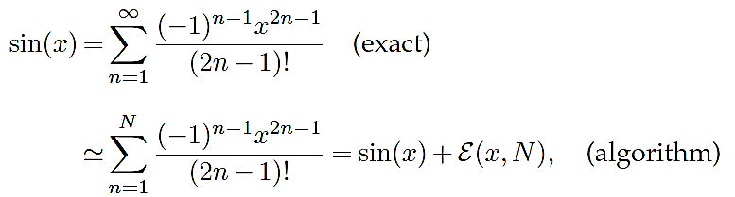
Continued…
Approximation Errors
imprecision arising from simplifying the mathematics so that a problem can be solved on the computer.
They include the replacement of infinite series by finite sums, infinitesimal intervals by finite ones, and variable functions by constants. For example,

Slide 12

Continued…
Round-off errors:
imprecision arising from the finite number of digits used tostore floating-point numbers.
These “errors” are analogous to the uncertainty in the measurement of a physical quantity encountered in an elementary physics laboratory.
The overall round-off error accumulates as the computer handles more numbers, that is, as the number of steps in a computation increases, and may cause some algorithms to become unstable with a rapid increase in error.
In some cases, round-off error may become the major component in your answer, leading to what computer experts call garbage.

Slide 13
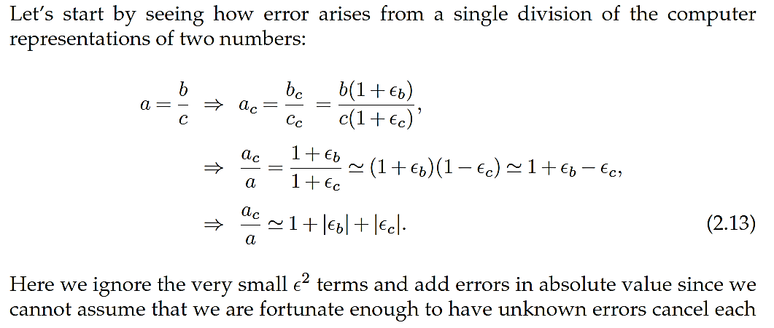
Round-off Error in a Single Step

Slide 14
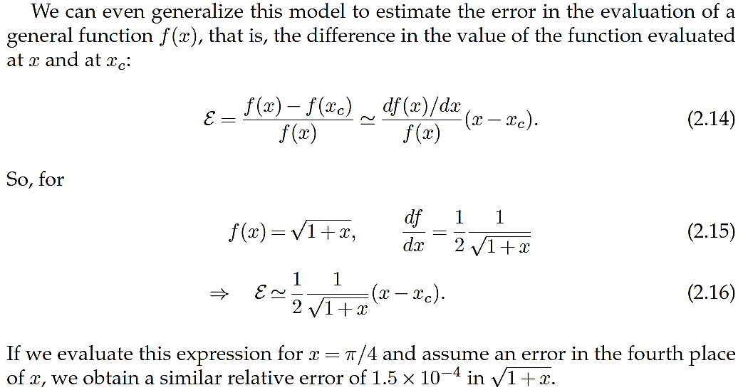
Continued…

Slide 15
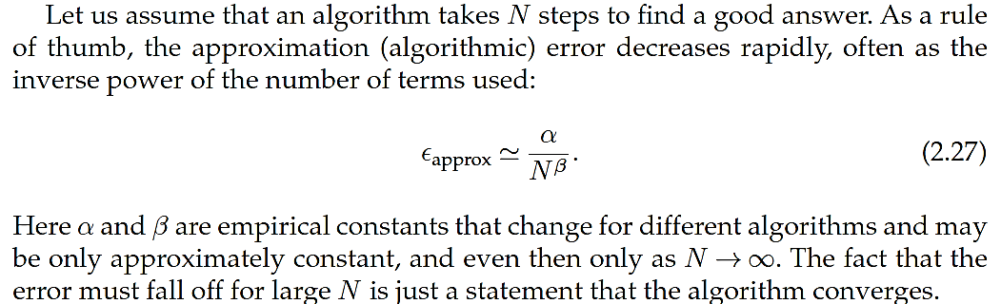
Algorithmic Error after ‘N’-Iterations (Typical Behavior)

Slide 16
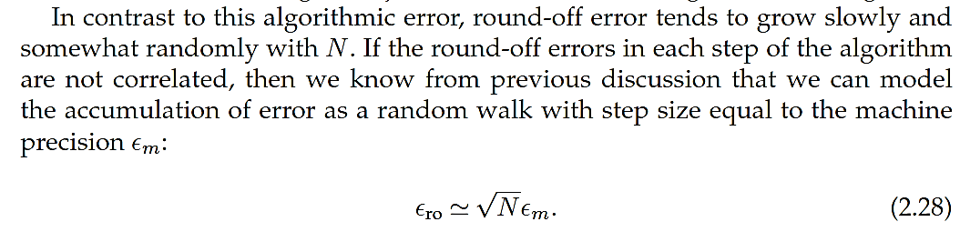
Round-off Errors (Typical Behavior)

Slide 17
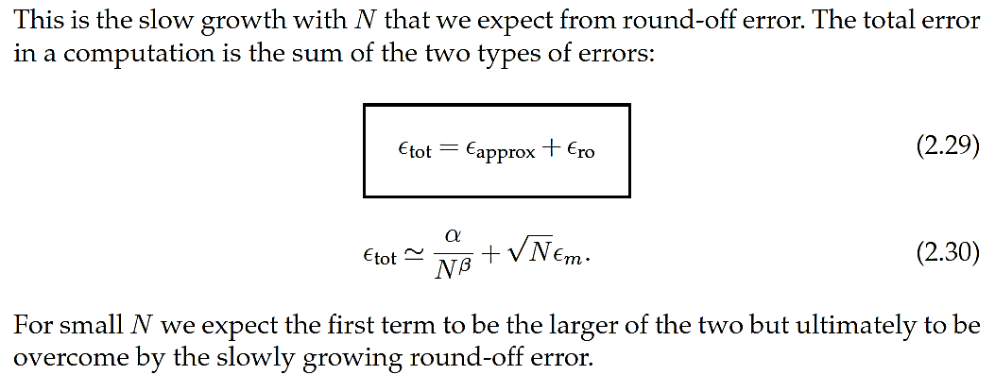
Total Error:

Slide 18
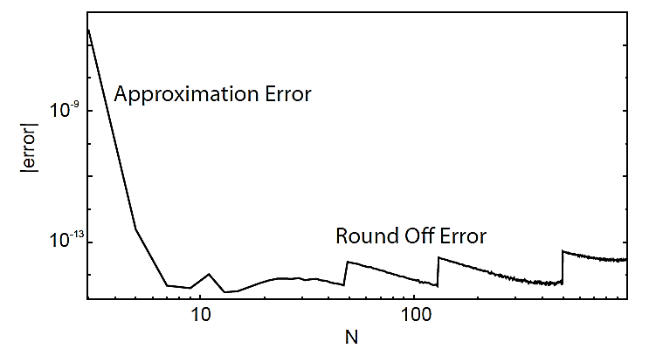
Total Error (typical case study)
c

Slide 19
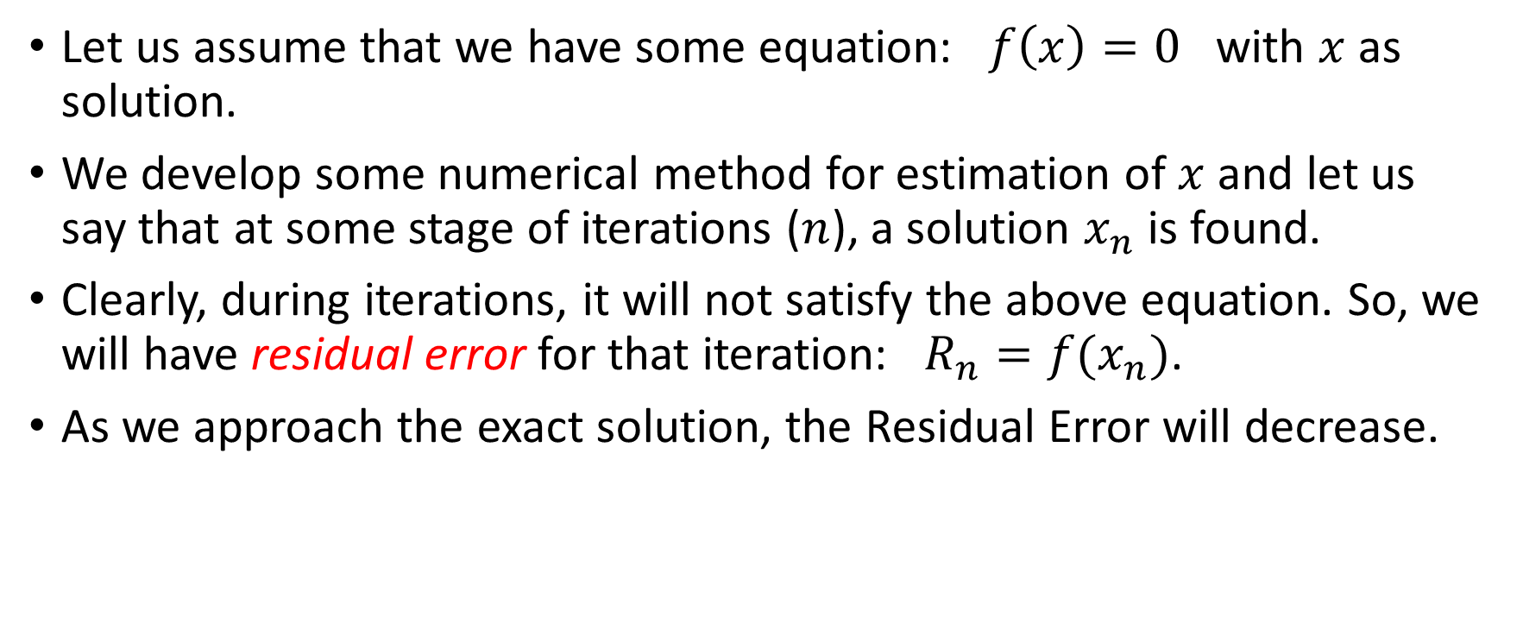
Residual Error
Let us assume that we have some equation: $f\left(x\right)=0$ with $x$ as solution.
We develop some numerical method for estimation of $x$ and let us say that at some stage of iterations ($n$), a solution $x_{n}$ is found.
Clearly, during iterations, it will not satisfy the above equation. So, we will have residual error for that iteration: $R_{n}=f(x_{n})$.
As we approach the exact solution, the Residual Error will decrease.

Slide 20
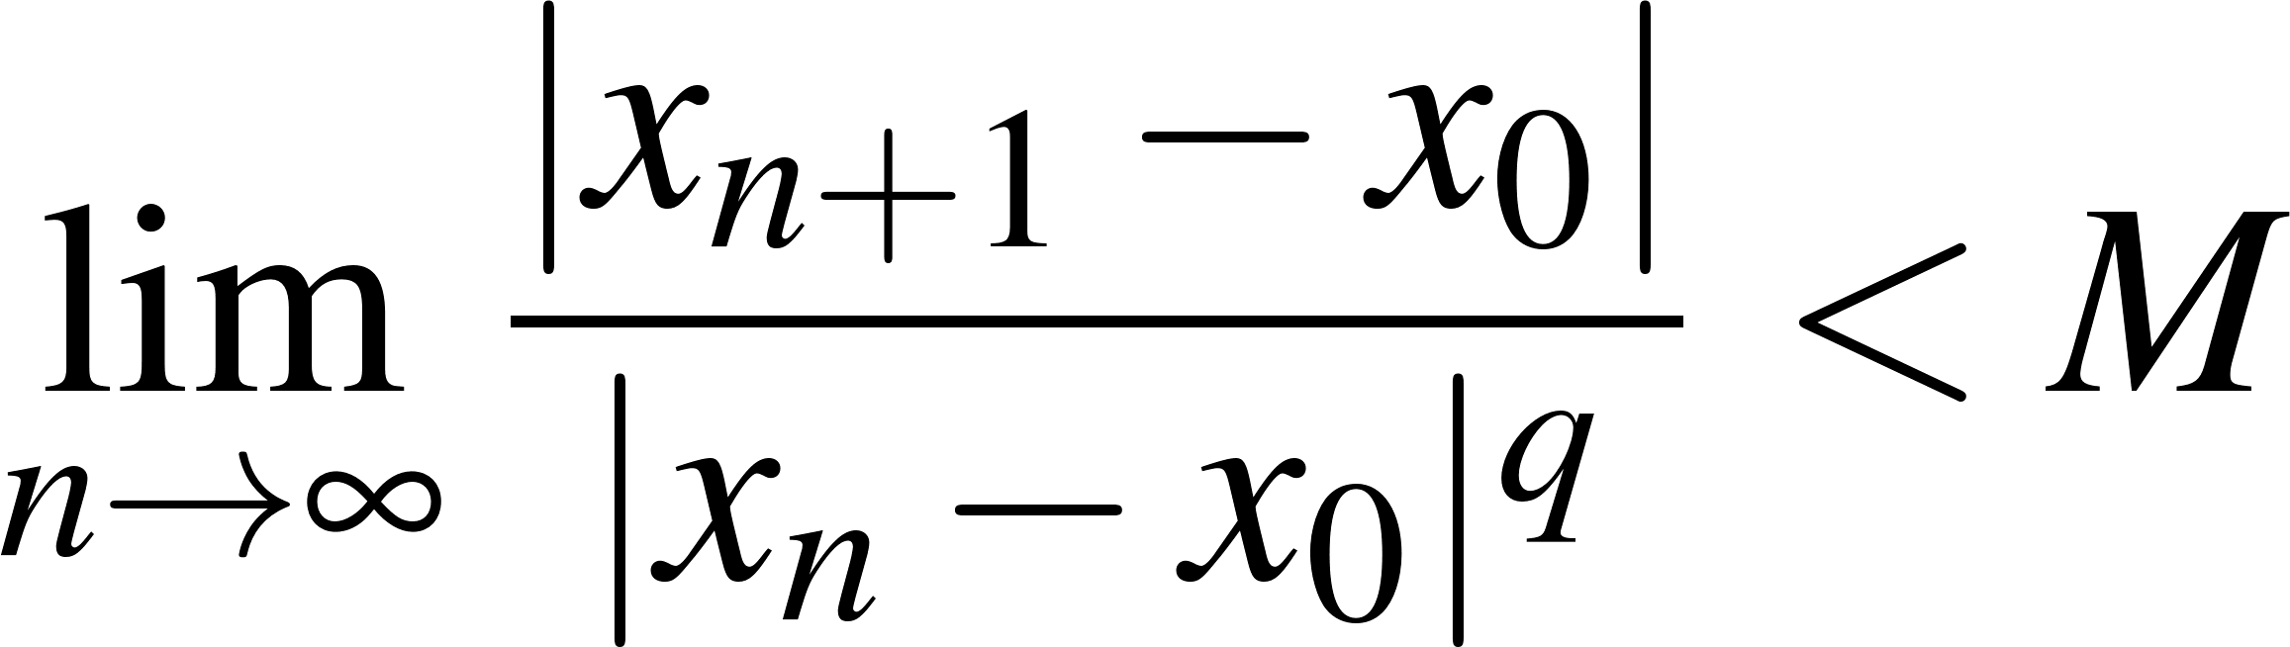
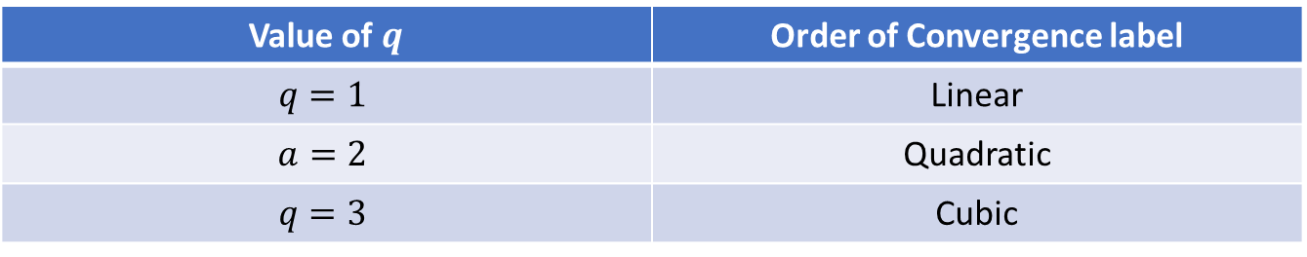

Order of Convergence
A sequence (of approximate solutions) is said to converge with order $q$ to $x_{0}$ for $q≥1$ if:
We have:
Value of $q$ | Order of Convergence label
$$q=1$$ | Linear
$$a=2$$ | Quadratic
$$q=3$$ | Cubic

Slide 21
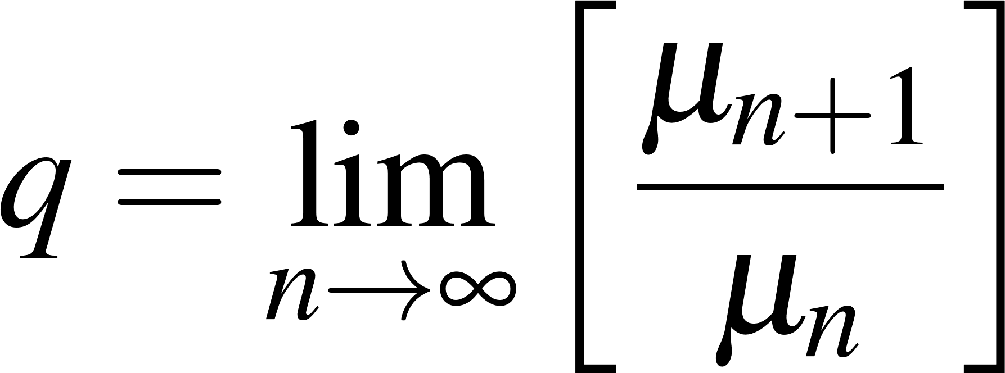
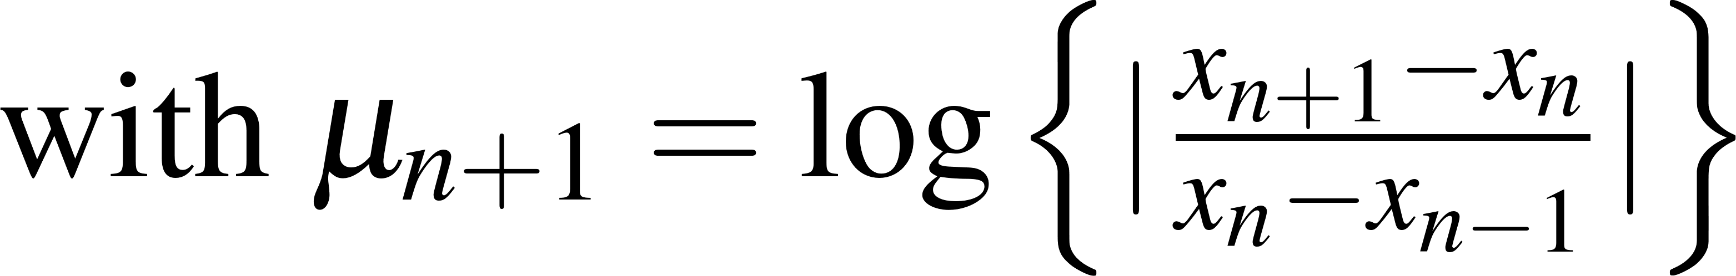
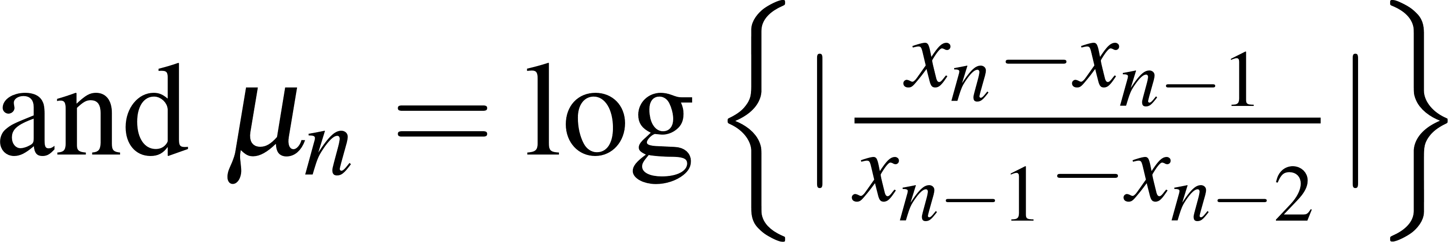

Practical method for estimation of ‘$q′$
In practice, the following relation is used for estimation of ‘order-of-convergence’:

Slide 22
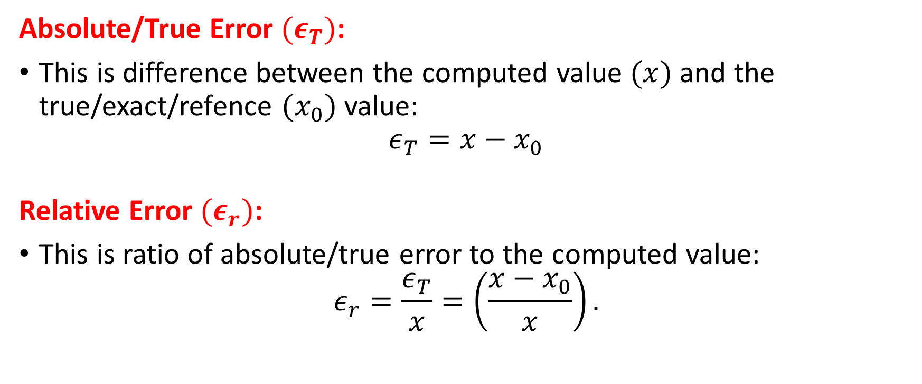
Broad Classification of Errors
Absolute/True Error $(ε_{T})$:
This is difference between the computed value $(x)$ and the true/exact/refence $(x_{0})$ value:
$$ε_{T}=x−x_{0}$$
Relative Error $(ε_{r})$:
This is ratio of absolute/true error to the computed value:
$$ε_{r}=\frac{ε_{T}}{x}=\left(\frac{x−x_{0}}{x}\right).$$

Slide 23
Human Errors
These are errors introduced due to human imperfections or mistakes.
Human errors can occur at any stage of the problem solving cycle. Some common types of errors are :
Lack of understanding of the problem (physical system)
Overlooking of some basic assumptions required for formulating the model or making wrong assumptions (Modelling Error)
Errors in deriving the mathematical equation or using a model that does not describe adequately the physical system under study (Modelling error)
Selecting a wrong numerical method for solving a mathematical model.

Slide 24
Human Errors (Continued)
Selecting a wrong algorithm for implementing a numerical method.
Programming mistakes
Mistakes in Data input such as misprints, giving values column-wise instead of a row wise to a matrix , forgetting a negative sign,etc.
Wrong guess of initial values
All these mistakes can be avoided through a reasonable understanding of the problem and the numerical solution method, use of good programming techniques and tools, effective code reviews and testing.

Slide 25
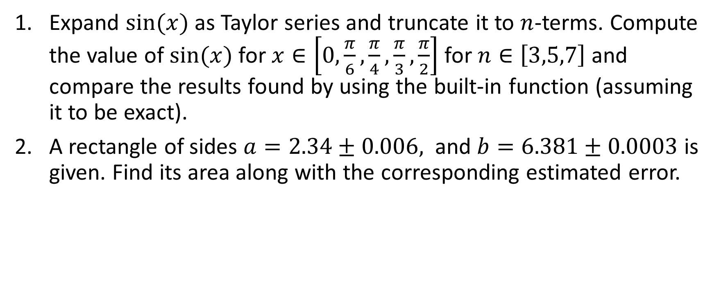
Excercise
Expand $sin⁡(x)$ as Taylor series and truncate it to $n$-terms. Compute the value of $sin⁡(x)$ for $x∈\left[0,\frac{π}{6},\frac{π}{4},\frac{π}{3},\frac{π}{2}\right]$ for $n∈\left[3,5,7\right]$ and compare the results found by using the built-in function (assuming it to be exact).
A rectangle of sides $a=2.34±0.006,$ and $b=6.381±0.0003$ is given. Find its area along with the corresponding estimated error.

